Slide 1

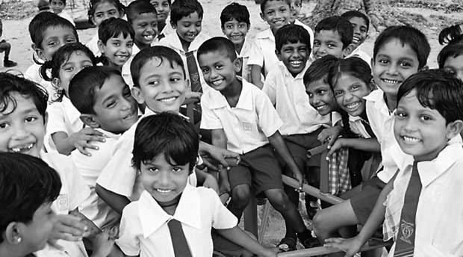
57% of teachers are graduates
3% of teachers are untrained
7.8% of highest untrained teachers in a district - Mullaitivu
Sri Lankan Government School Insights
10, 146 – Total govt schools
892 - # of schools in Kurunegala district, highest in a district
104 - # of schools in Kilinochchi, lowest in a district
29 - # of schools shut down since 2018
87 – With this trend 87 number of schools may be shutdown by 2030
50.7% of the schools less than 200 students
43.5% of the students learn in schools more than 1000 students
66% of the teachers are in schools less than 1000 students
21 & 11 – Highest and lowest student to teacher ratio in a district, Colombo and Jaffna
73% Schools of the island is less than 25 teachers
Teachers needs to be distributed
118 the Highest number of schools less than 50 students in a district, Badulla. There are three more districts with more than 100 schools less than 50 students Kegalle, Ratnapura and Kurunegala
284 of Highest number of schools with less than 10 teachers in a district, Kurunegala
76% of teachers are females
Most of students who did Art stream in A/L is coming into government teaching and it is reflected from gender distribution of A/L stream selection.
~66% of Art students are Females

